Slide 1
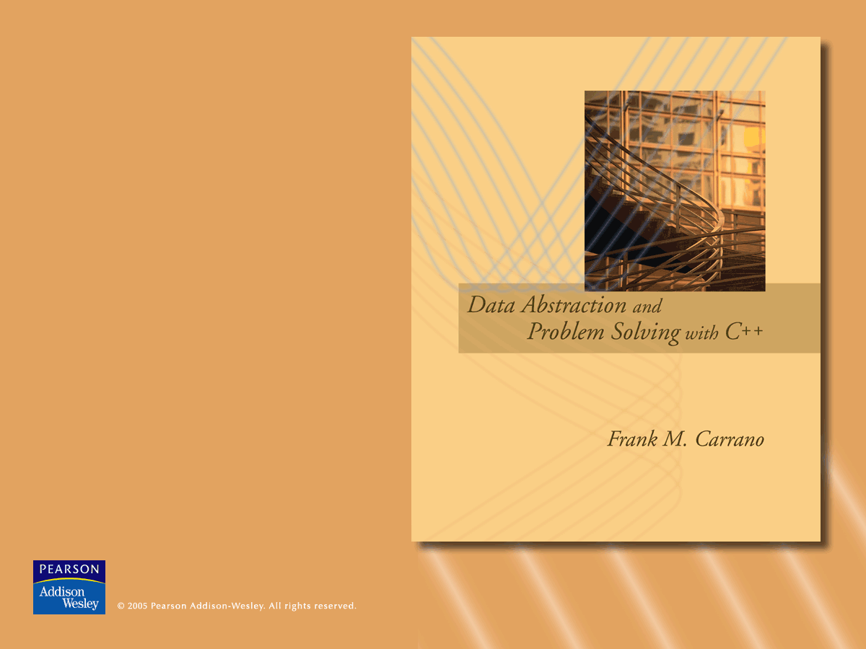
Chapters 8 and 9
ADT List:
Array-Based Implementation

Slide 2
Abstract Data Types
Typical operations on data
  Add data to a data collection
  Remove data from a data collection
  Ask questions about the data in a data collection
© 2005 Pearson Addison-Wesley. All rights reserved
3-<number>

Slide 3
Abstract Data Types
Data abstraction
  Asks you to think what you can do to a collection of data independently of how you do it
  Allows you to develop each data structure in relative isolation from the rest of the solution
© 2005 Pearson Addison-Wesley. All rights reserved
3-<number>

Slide 4
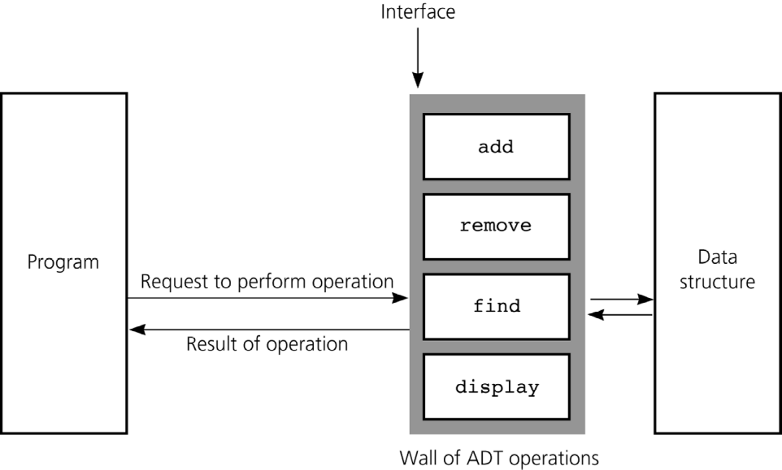
Abstract Data Types
An abstract data type (ADT) is composed of
  A collection of data
  A set of operations on that data
Specifications of an ADT indicate what the ADT operations do (but not how to implement them)
Implementation of an ADT includes choosing a particular data structure
© 2005 Pearson Addison-Wesley. All rights reserved
3-<number>

Slide 5
The ADT List
Except for the first and last items, each item has a unique predecessor and a unique successor
Head (or front) does not have a predecessor
Tail (or end) does not have a successor
© 2005 Pearson Addison-Wesley. All rights reserved
3-<number>

Slide 6
The ADT List
Items are referenced by their position within the list
Specifications of the ADT operations
  Define the contract for the ADT list
  Do not specify how to store the list or how to perform the operations
ADT operations can be used in an application without the knowledge of how the operations will be implemented
© 2005 Pearson Addison-Wesley. All rights reserved
3-<number>

Slide 7
The ADT List
ADT List operations
  Create an empty list
  Determine whether a list is empty
  Determine the number of items in a list
  Add an item at a given position in the list
  Remove the item at a given position in the list
  Remove all the items from the list
  Retrieve (get) item at a given position in the list
© 2005 Pearson Addison-Wesley. All rights reserved
3-<number>

Slide 8
The ADT List
The ADT sorted list
  Maintains items in sorted order
  Inserts and deletes items by their values, not their positions
© 2005 Pearson Addison-Wesley. All rights reserved
3-<number>

Slide 9
Designing an ADT
The design of an ADT should evolve naturally during the problem-solving process
Questions to ask when designing an ADT
  What data does a problem require?
  What operations does a problem require?
© 2005 Pearson Addison-Wesley. All rights reserved
3-<number>

Slide 10
Implementing ADTs
Choosing the data structure to represent the ADT’s data is a part of implementation
  Choice of a data structure depends on
    Details of the ADT’s operations
    Context in which the operations will be used
Implementation details should be hidden behind a wall of ADT operations
  A program would only be able to access the data structure using the ADT operations
© 2005 Pearson Addison-Wesley. All rights reserved
3-<number>

Slide 11
An Array-Based ADT List
A list’s items are stored in an array items
Both an array and a list identify their items by number
© 2005 Pearson Addison-Wesley. All rights reserved
3-<number>

Slide 12
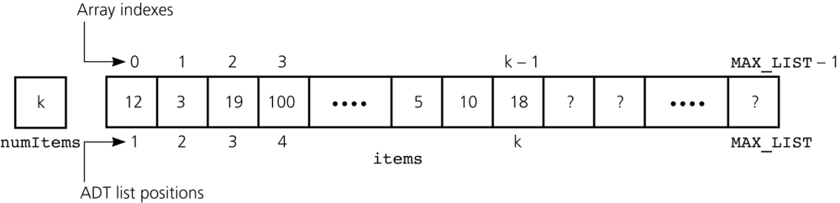
An Array-Based ADT List
A list’s k^{th} item will be stored in items[k-1]
Figure 3.11 An array-based implementation of the ADT list
© 2005 Pearson Addison-Wesley. All rights reserved
3-<number>

Slide 13
Array-Based ADT List Implementation
// *************************************
// Header file ListA.h for the ADT list
// Array-based implementation
// *************************************
const int MAX_LIST = maximum-size-of-list;
typedef desired-type-of-list-item ListItemType;
class List{
public:
List(); // default constructor
// destructor is supplied by
// compiler
© 2005 Pearson Addison-Wesley. All rights reserved
3-<number>

Slide 14
Array-Based ADT List Implementation
// list operations:
bool isEmpty() const;
// Determines whether a list is empty.
// Precondition: None.
// Postcondition: Returns true if the
// list is empty; otherwise returns
// false.
© 2005 Pearson Addison-Wesley. All rights reserved
3-<number>

Slide 15
Array-Based ADT List Implementation
int getLength() const;
// Determines the length of a list.
// Precondition: None.
// Postcondition: Returns the number of
// items that are currently in the list.
© 2005 Pearson Addison-Wesley. All rights reserved
3-<number>

Slide 16
Array-Based ADT List Implementation
bool retrieve(int index,
ListItemType& dataItem) const;
// Retrieves a list item by position.
// Precondition: index is the number of
// the item to be retrieved.
// Postcondition: If 1 <= index <=
// getLength(), dataItem is the value of
// the desired item and the function
// returns true. Otherwise it returns
// false.
© 2005 Pearson Addison-Wesley. All rights reserved
3-<number>

Slide 17
Array-Based ADT List Implementation
bool insert(int index,
ListItemType newItem);
// Inserts an item into the list at
// position index.
// Precondition: index indicates the
// position at which the item should be
// inserted in the list.
// Postcondition: If insertion is
// successful, newItem is at position
// index in the list, and other items are
// renumbered accordingly, and the
// function returns true; otherwise it
// returns false.
// Note: Insertion will not be successful
// if index < 1 or index > getLength()+1.
© 2005 Pearson Addison-Wesley. All rights reserved
3-<number>

Slide 18
Array-Based ADT List Implementation
bool remove(int index);
// Deletes an item from the list at a
// given position.
// Precondition: index indicates where
// the deletion should occur.
// Postcondition: If 1 <= index <=
// getLength(), the item at position
// index in the list is deleted, other
// items are renumbered accordingly, and
// the function returns true; otherwise
// it returns false.
© 2005 Pearson Addison-Wesley. All rights reserved
3-<number>

Slide 19
Array-Based ADT List Implementation
private:
ListItemType items[MAX_LIST];
// array of list items
int size;
// number of items in list
int translate(int index) const;
// Converts the position of an item in a
// list to the correct index within its
// array representation.
}; // end List class
© 2005 Pearson Addison-Wesley. All rights reserved
3-<number>

Slide 20
Array-Based ADT List Implementation
// **************************************
// Implementation file ListA.cpp for the ADT
// list
// Array-based implementation
// *****************************************
#include "ListA.h" //header file
List::List() : size(0){
} // end default constructor
© 2005 Pearson Addison-Wesley. All rights reserved
3-<number>

Slide 21
Array-Based ADT List Implementation
bool List::isEmpty() const{
return size == 0;
} // end isEmpty
© 2005 Pearson Addison-Wesley. All rights reserved
3-<number>

Slide 22
Array-Based ADT List Implementation
int List::getLength() const{
return size;
} // end getLength
© 2005 Pearson Addison-Wesley. All rights reserved
3-<number>

Slide 23
Array-Based ADT List Implementation
int List::translate(int index) const{
return index - 1;
} // end translate
© 2005 Pearson Addison-Wesley. All rights reserved
3-<number>

Slide 24
Array-Based ADT List Implementation
bool List::retrieve(int index,
ListItemType& dataItem) const{
bool success = (index >= 1) && (index <= size);
if (success)
dataItem = items[translate(index)];
return success;
} // end retrieve
© 2005 Pearson Addison-Wesley. All rights reserved
3-<number>

Slide 25
Array-Based ADT List Implementation
bool List::insert(int index, ListItemType newItem){
bool success = (index >= 1) &&
(index <= size + 1) &&
(size < MAX_LIST);
if (success){
// make room for new item by shifting all
// items at positions >= index toward the end
// of the list (no shift if index == size+1)
for (int pos = size; pos >= index; --pos)
items[translate(pos+1)] = items[translate(pos)];
// insert new item
items[translate(index)] = newItem;
++size; // increase the size of the list by one
}
return success;
} // end insert
© 2005 Pearson Addison-Wesley. All rights reserved
3-<number>

Slide 26
Array-Based ADT List Implementation
bool List::remove(int index){
bool success = (index >= 1) && (index <= size) ;
if (success){
// delete item by shifting all items at
// positions > index toward the beginning
// of the list (no shift if index == size)
for (int fromPosition = index+1;
fromPosition <= size;
++fromPosition)
items[translate(fromPosition-1)] =
items[translate(fromPosition)];
--size; // decrease the size of the list by one
}
return success;
} // end remove
© 2005 Pearson Addison-Wesley. All rights reserved
3-<number>

Slide 27
Summary
Data abstraction controls the interaction between a program and its data structures
Abstract data type (ADT): a set of data-management operations together with the data values upon which they operate
An ADT should be fully defined before any implementation decisions
Hide an ADT’s implementation by defining the ADT as a C++ class
© 2005 Pearson Addison-Wesley. All rights reserved
3-<number>

